Slide 2
THE BRAND ETHOS
True expressions of Sonoma County
We are passionate about crafting small batch wines expressive of the unique clones and AVA's reflected in our Sonoma County Pinot Noir. Overseeing our vineyard operations is Rob Harris who has been farming grapes for us for over a dozen years. He sources the fruit for Head High Wines from like-minded, select growers in Sonoma County with a dedication to finding the highest quality fruit that embodies the coastal influence of this growing region.
The ocean is at the heart of it all
Sonoma County’s proximity to the Pacific Ocean in the fog corridor offers warm summer days, and cool nights creating the perfect growing region for our wines. We produce local wines made from unique combinations of the sun, earth and sea.
We are committed to the greater good of the ocean through our name. Head High is a term for the perfect surfing wave. We donate a percentage of the sale of each bottle of Head High Wines to environmental projects that support a cleaner ocean and healthier earth.
Authentic qualities
Our winemaker Britt Richards takes a minimal approach to making these wines, focused on bringing out the qualities of the fruit. Our vineyards are planted with many of the same clonal selections, each one producing a different result based on the diversity of weather throughout Sonoma County. This results in a dynamic vineyard blend of each varietal based on its proximity to the ocean breezes so integral in growing Chardonnay and Pinot Noir.

Slide 3
VERIFIED CLIMATE NEUTRAL
Sustainable Surf Partnership
Head High Wines donates a portion of the proceeds of every bottle of wine sold globally to restore ocean health. We have donated over $100,000 towards reversing climate change and continue to expand our partnership with supporting the SeaTrees by Sustainable Surf projects along the coast of California, the Hawaiian Islands and around the world. https://sea-trees.org/pages/brand-partnerships
Ocean Positive Brand Certification—Verified Climate Neutral
Sustainable Surf measures the impact of each brand using the United Nations Sustainable Development Goals. Head High Wines has eliminated our carbon footprint. The certification as an Ocean Positive brand verifies that we are taking action to sequester more carbon emissions than we’re creating - having a positive impact on the ocean and the life it supports. https://sea-trees.org/pages/ocean-positive-brands
Shared Core Values
We seek out accounts that respect and support our compassion to our community and the earth, who share similar core values such as traceable local fish sourcing, sustainably farmed ingredients and food recycling programs. Several specific choices that make our brand environmentally sound include sourcing the glass for our wine bottles locally within 100 miles from the winery, utilizing screw cap closures to minimize cork use and silk screening our labels to avoid additional use of paper and petroleum-based inks that are unrecyclable. Our relationships with like-minded businesses to connect us at a meaningful level. We consider each placement of our wines as an on-going partnership and appreciate the opportunity to share mutual successes.
SeaTrees Projects Supported by Head High Wines
Monterey, CA
https://youtu.be/i81rXzkkLhw
Palos Verdes, CA
https://sea-trees.org/pages/palos-verdes-kelp
Maui, Hawaii
https://sea-trees.org/pages/project-waiwai

Slide 4
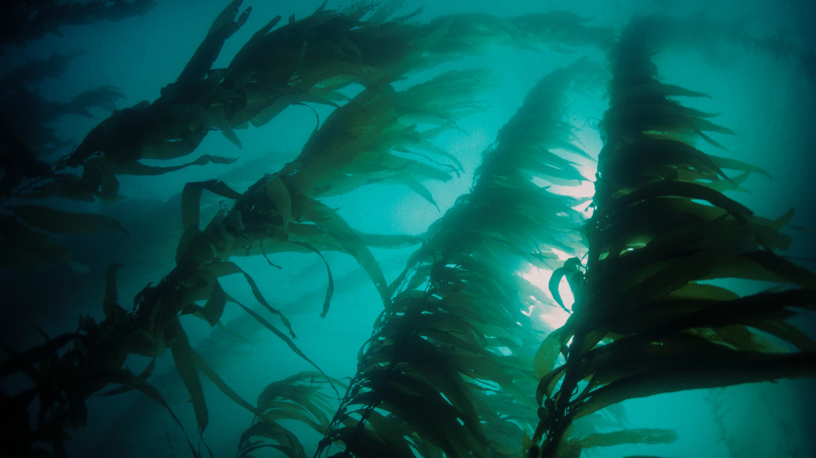
OCEAN ECOSYSTEMS ARE HIGHLY EFFECTIVE
AT SEQUESTERING CARBON
5X
THE CARBON STORAGE
90%
OF ALL CARBON
KELP
FORESTS
Mangrove forests can store 5-10X more CO2 per hectare than tropical rainforests.
In the global carbon cycle is stored in the ocean. This is where it should be sequestered to reverse climate change.
Globally, kelp forests sequester as much CO2 as the world’s mangroves. 10% of kelp breaks off and sinks into the deep ocean - sequestering the CO2 it contains.

Slide 5
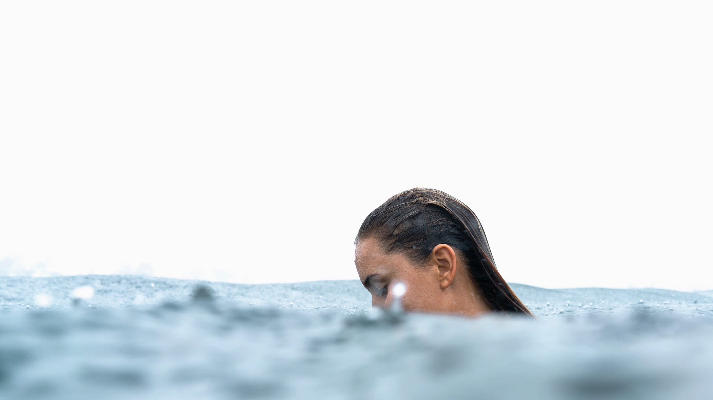
THE OCEAN HAS THE SUPERPOWER
TO REVERSE CLIMATE CHANGE
www.sea-trees.org
by 501c3 Non-Profit Sustainable Surf

